Slide 1
A professional and personal development opportunity for
emerging leaders who are formerly incarcerated or justice-involved.
Presenters
Erica Webster, Center on Juvenile and Criminal Justice (CJCJ)
John Pineda, Motivating Individual Leadership for Public Advancement (MILPA)

Slide 2
Instructions
Asking questions via webinar:
Open the chat window
Address questions to “Everyone”
Q&A at the end of the presentation
Ask questions through phone attendance:
Please email questions to nextgenfellowshipcal@gmail.com

Slide 3
About MILPA
Motivating Individual Leadership for Public Advancement (MILPA)
www.milpacollective.org
Foundation
Brief History of MILPA inception
Composition of Members
Theory
Culture Consciousness Movement Building
Cultivating Changemakers for the Next 7 Generations
Work
Juvenile Hall Construction/Bed Size Reduction
Rites of Passage Programming
Take it Outside Community Event
Training and Technical Assistance

Slide 4
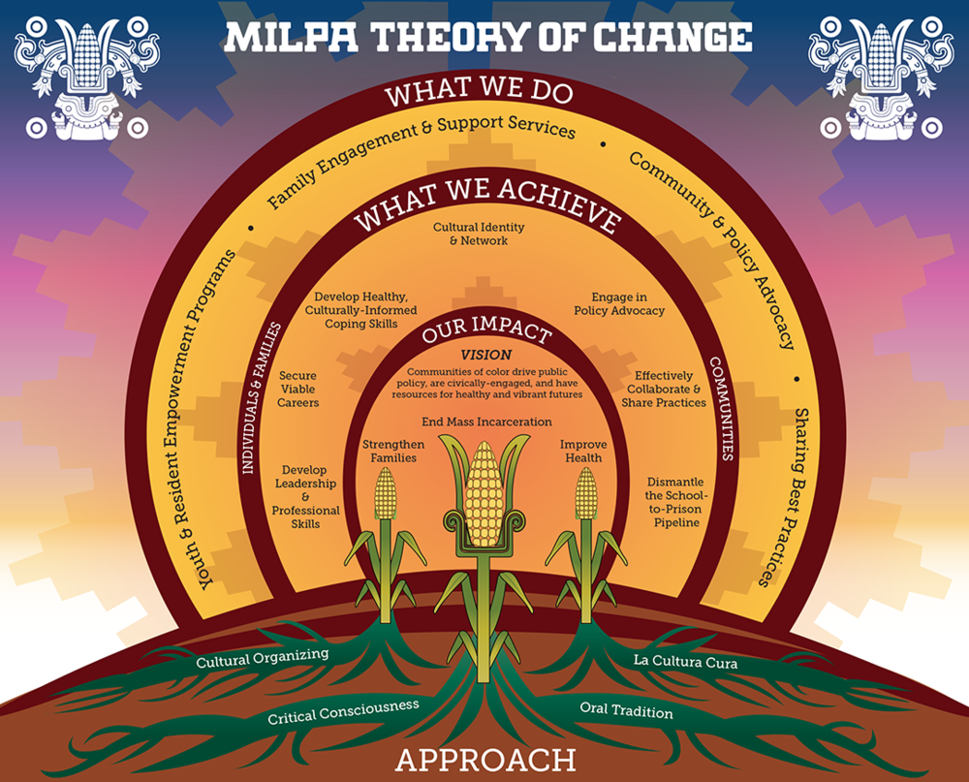

Slide 5
About CJCJ
Center on Juvenile and Criminal Justice (CJCJ)
www.cjcj.org
Mission: To reduce society’s reliance on incarceration as a solution to social problems.
Direct Services: juvenile and adult case management
Technical Assistance: consulting services, and juvenile court disposition services
Policy Analysis: legislation, advocacy, and research
Recent Policy Projects
Advocating for Prop 57 and ending the prosecution of youth in adult court
Studying Prop 47’s impact on crime
Monitoring conditions at DJJ/CYA and county jail construction funding
Analyzing the historic youth crime decline
Co-sponsoring legislation (SB 190 and 439)
BSCC advocacy - Monitoring county jail construction funding, and improving the minimum standards for juvenile halls and camps

Slide 6
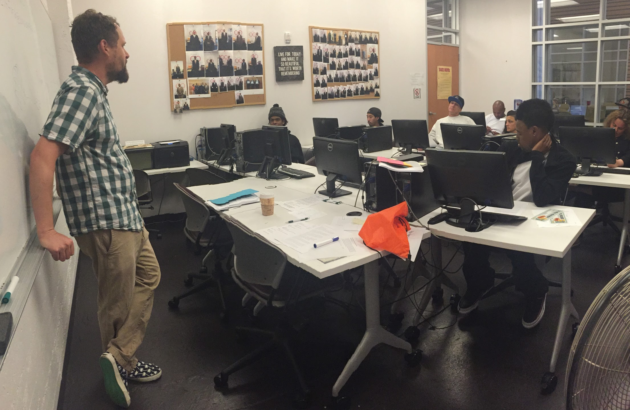
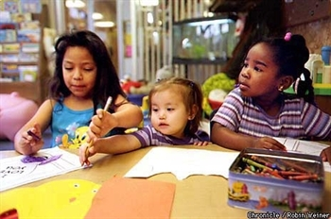
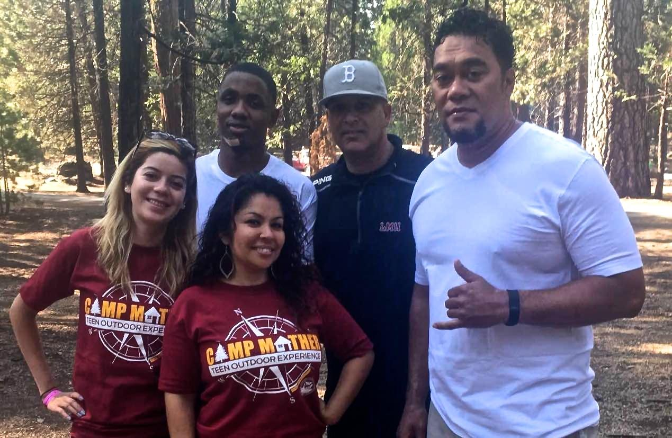
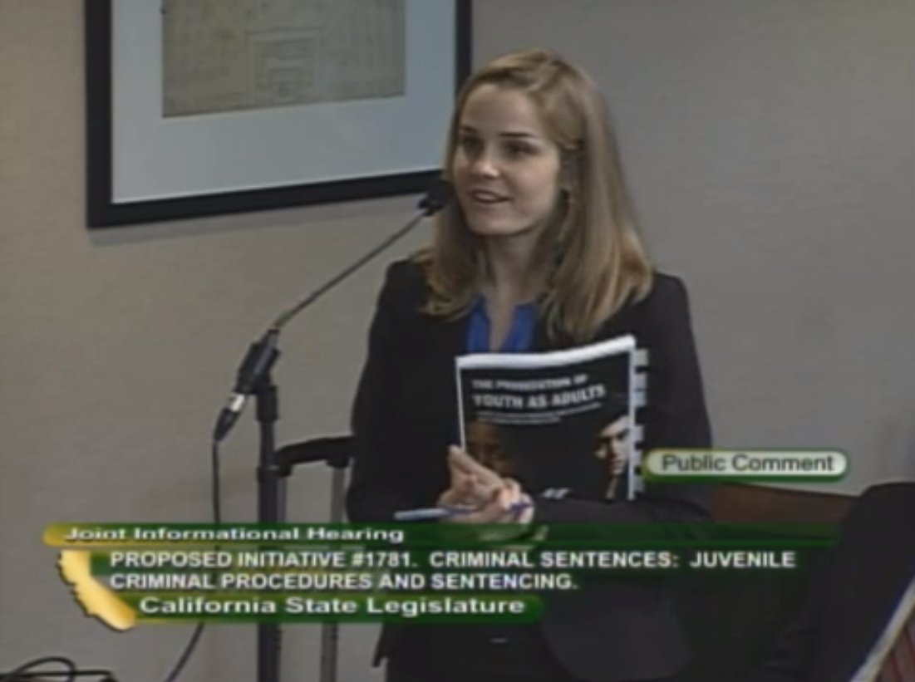
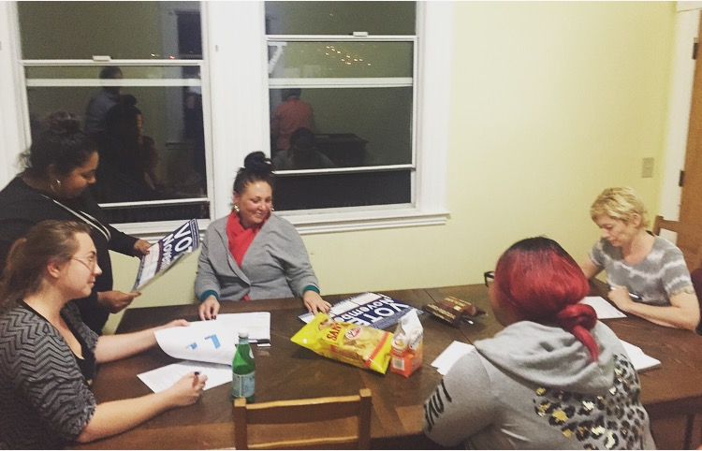
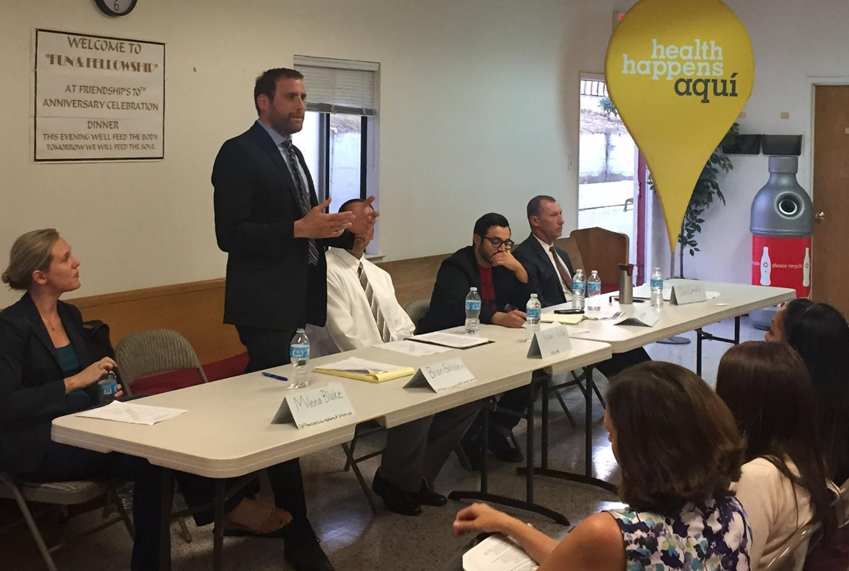
About CJCJ
Employment training
Children’s Waiting Rooms
Youth programs
Legislative advocacy
Cameo House
Prop 47

Slide 7
About the Fellowship
Next Generation Fellowship website
July 17-18, 2017
Sacramento, CA
Accommodations will be provided and some travel costs will be reimbursed.
Purposes
To invest in the leadership development and knowledge base of justice-involved individuals, and place them in decision-making positions.
To recognize and use justice-involvement as a form of expertise.
To build up grassroots expertise about local and state systems and provide the tools needed for transformative criminal and juvenile justice reform
To identify and strategize around opportunities for change.

Slide 8
Training focus
Understand state and local infrastructure - The California State Legislature, the Board of State and Community Corrections (BSCC), county Boards of Supervisors.
Practice strategic messaging that promotes the values of reform and the lived experiences of justice-involved individuals to change narratives typically dominated by law enforcement or fear.
Dialogue and brainstorm around how to positively impact community health and safety.
Map personal and collective strengths and challenges, and strategize possible solutions.

Slide 9
Application
Online application is due by 11:59 pm on May 21, 2017. In you application, you will be asked to include:
General contact information
Areas of policy interest
Professional and education history
Two references
Two short essays ( max 300 words each)
Personal statement (max 400 words)
Qualifications
Formerly incarcerated and/or justice-involved adults (18+) with an interest in leveraging lived experience to effect change.
Must be a resident of California.
Demonstrated commitment to advocating for criminal and juvenile justice reform.
Interest in career advancement, education, and skill development related to social justice.
Currently engaged with a community or advocacy organization in some way (e.g. internship, volunteer work, employment).
Demonstrated ties to your community and a passion for making it safer.
Visit “How to Apply” to review application instructions and access the online application.

Slide 10
FAQs
Do I have to be formerly incarcerated to be eligible?
No, having served time in a youth facility, jail or prison is not required to be eligible for this fellowship. However, the goal of this fellowship is to develop skills of individuals with justice-involvement and build on these experiences for advocacy. Some level of justice-involvement is required, whether this includes you or a family member.
Can I save and resume my application at a later time?
No, the application must be completed and submitted all at once. However, you can view the entire application so you can prepare the required materials ahead of time before submitting.
Who should I include as a reference?
We would prefer a professional or academic reference that does not include friends or family. Examples could include teachers, mentors, volunteer supervisors, managers or employers.
How many fellows will be accepted into this program?
A maximum of 12 applicants will be selected.

Slide 11
Resources
Next Generation Fellowship
http://www.cjcj.org/Next-Generation-Fellowship.html
CJCJ-MILPA Partnership
http://www.cjcj.org/Next-Generation-Fellowship/Who-are-CJCJ-and-MILPA-.html
How to Apply
http://www.cjcj.org/Next-Generation-Fellowship/How-to-Apply.html
FAQs
http://www.cjcj.org/Next-Generation-Fellowship/FAQs.html
Webinar Recording
http://www.cjcj.org/Next-Generation-Fellowship/May-9th-Webinar.html
Application
https://docs.google.com/forms/d/e/1FAIpQLSfiG1BjI6qj4yR3DMKqeYbTGhtJqgHuMuf4qmhfqlyhR903jQ/viewform?c=0&w=1
Contact nextgenfellowhshipcal@gmail.com with questions.

Slide 12
Questions?

