Slide 1
Race and Ethnic Discrimination Against Youth in American History

Slide 2
Puritan View of Childhood and child rearing practices
Children born in sin
Child rearing emphasized piousness to God and strict discipline
Parental discipline key to avoiding Gods wrath and eternal damnation
Stubborn Child Law of 1646
Parents discouraged from showing affection to impress adherence to Gods law
Practice of “sending out” to other families
Heavy emphasis on education and the ability to read

Slide 3
European-American policy towards Native American Children
Saw native American children as godless and savage
Viewed European settlement and expansion as the march of civilization
Wars led to the binding out of Native American children to be properly raised by white Europeans
Later led to special boarding schools being established to “Christianize” and enculturate Native American children into White society (Civilization Act Fund, 1819)

Slide 4
Attitudes towards native Americans 19the century
A great general has said that the only good Indian is a dead one. In a sense, I agree with the sentiment, but only in this: that all the Indian there is in the race should be dead. Kill the Indian in him and save the man. Richard Henry Pratt (1879) founder of the Carlisle Indian Industrial School

Slide 5
Treatment of immigrant children in 19th Century America
Immigration and industrialization resulted in greater urbanization
Urban population surge led to increased poverty and desperate living conditions
Hordes of poor children wandering urban streets
Rise of urban street gangs
Immigrant children viewed as dangerous class needing to be tamed

Slide 6
Response to surge of immigrant youth
1819 Society of the Prevention of Pauperism found
Report on the Penitentiary System in America published (1922)
Call for creation of youth penitentiaries
1825 New York House of Refuge established

Slide 7
New York House of Refuge

Slide 8
Parens Patriae and the role of the state in the rearing of children
Crouse case of 1838
Affirmed that the state is the supreme parent
State or its designated agents determined best interest of child
Led to child saving movement

Slide 9
Discrimination against Chinese youth (1860)
Arrived in California with the gold rush
Immigration fueled by political unrest – collapse of the Qing Dynasty
Later worked on the transcontinental railroad
Considered reliable and hardworking
Considered a threat by white working class
Chinese exclusion act of 1882 -1943
Supreme Court Justice John Marshall Harlan: The Chinese "a race so different from our own that we do not permit those belonging to it to become citizens of the United States. Persons belonging to it are, with few exceptions, absolutely excluded from our country. I allude to the Chinese race."[

Slide 10
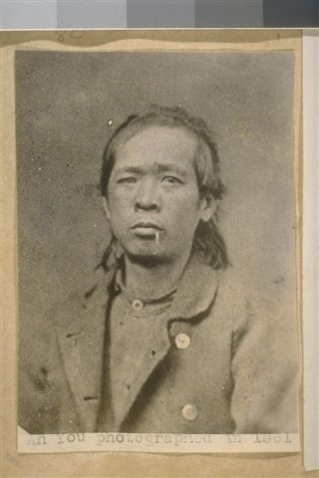
Chinese youth and the Industrial School
As a result of anti-Chinese sentiment in the 1860s a growing number of Chinese youth in San Francisco were targeted by law enforcement and committed to the Industrial School.

Slide 11
Depictions of 19th discrimination against the Chinese

Slide 12
Irish Immigration to America
Expanded in early 19th century
Increased with the great famine of 1846
Mostly impoverished escaping starvation
Mostly Catholic
Sought work as laborers, domestic service
Depicted as drunkards and prostitutes
Faced discrimination
Settled in isolated ghettos
Children primary target of 19th century child savers

Slide 13
Discrimination against Irish youth in the 19th century

Slide 15
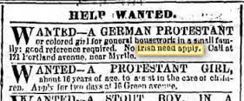

Slide 16
Chinese and Irish peril

Slide 17
Discrimination against Italians

Slide 18
Anti- Italian NY Times Editorial
These sneaking and cowardly Sicilians, the descendants of bandits and assassins, who have transported to this country the lawless passions, the cut-throat practices, and the oath-bound societies of their native country, are to us a pest without mitigation. Our own rattlesnakes are as good citizens as they...Lynch law was the only course open to the people of New Orleans. (March 16, 1891)

Slide 19
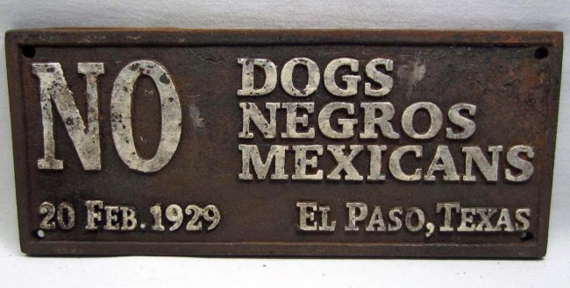
Discrimination against Mexican Americans

Slide 20
Discrimination against Mexican Americans in California juvenile justice system
Eugenics and hereditary science
California sterilization law (1909)
Development of the Stanford Binet IQ test
California Bureau of Juvenile Research established at Whittier State School
“Negroes and Mexican-Indians show a greater tendency to delinquency than the whites… This relationship is probably due to the higher intelligence of the whites” (Williams, 1915, 9).

